Slide 1

HAND GESTURE RECOGNITION AND CURSOR CONTROL & PAINT
Aniket vishwakarma
Riya Vishwakarma
Neeraj Kumar Yadav
Ujwal Yadav
Mentor-: Vikash Singh

Slide 2
INTRODUCTION
AS Computer Technology continue to develop, people have a smaller and smaller electronic devices .
increasingly we are recognizing the important of human computer interaction and in particular vision-based gesture and object recognition
in our project we have proposed a novel approach that the use of video devices to control the mouse system and having a paint.
we have implant employed the several image processing algorithm to implant this

Slide 3
PROJECT SCOPE
Tell for most laptop touchpad is not the most comfortable and convenient
Real time application
This project remove the requirement of having a physical hardware
This can be used in AI powered Car , Appliances

Slide 4
Goal and objective
The goal is to manage computers and other devices with gestures rather than pointing and clicking a mouse or touching a display directly
Reduce the cost of hardware

Slide 5
Problem statement
To design a virtual mouse which detects hand gesture pattern instead of physical device
basically, we use a fingertip and palm detection for detecting the our hand which is captured by a webcam
Here, different fingertip act as a object that webcam sense
the camera is positioned such a way that it recognize the moment of fingertip and perform the some particular mouse task

Slide 6
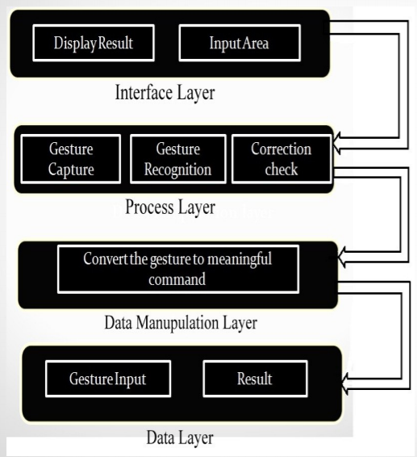
Architecture
There are following layer:
Interface Layer
Process Layer
Data Manipulation Layer
Data Layer

Slide 7




DAY 1 : literature survey

Slide 8
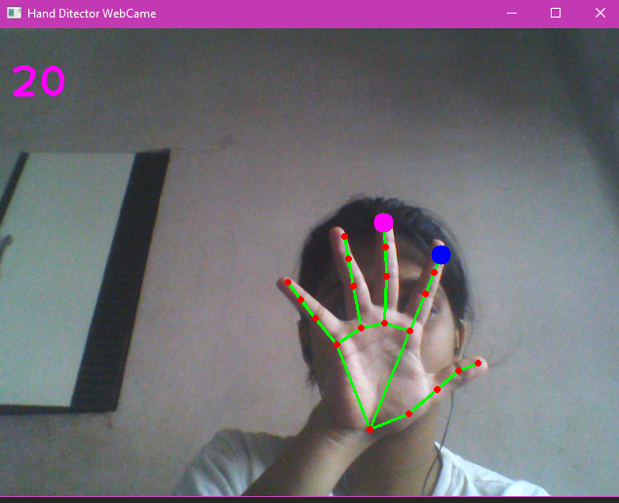
Day 2 : HANDTRACKING MODULE

Slide 9
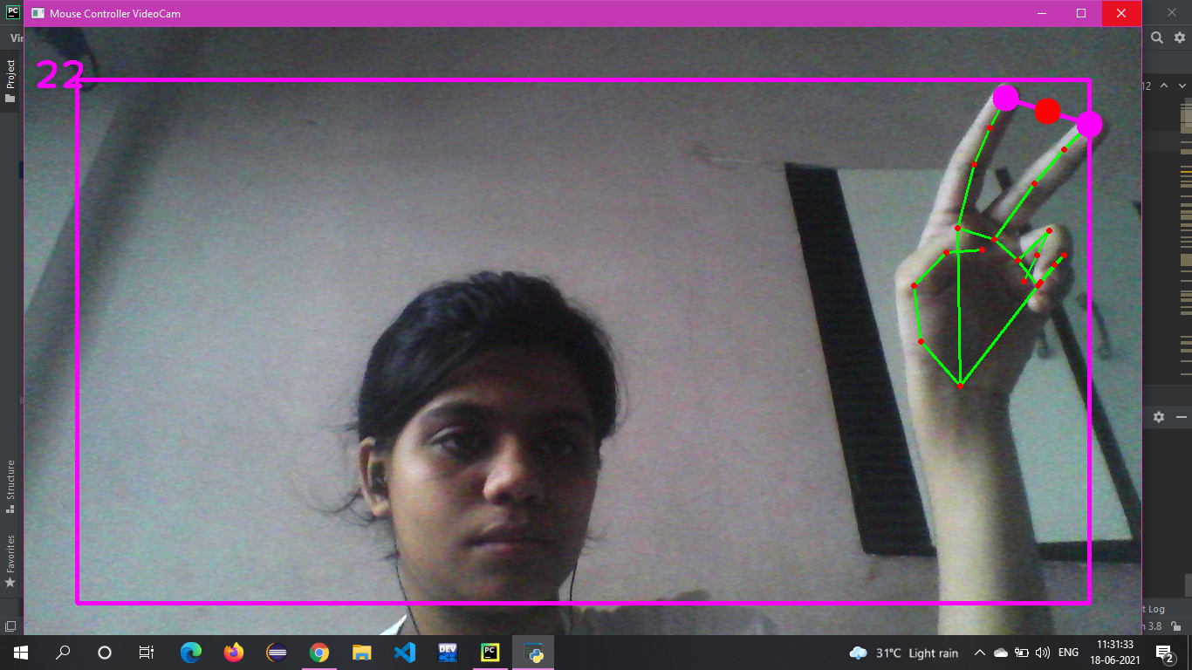
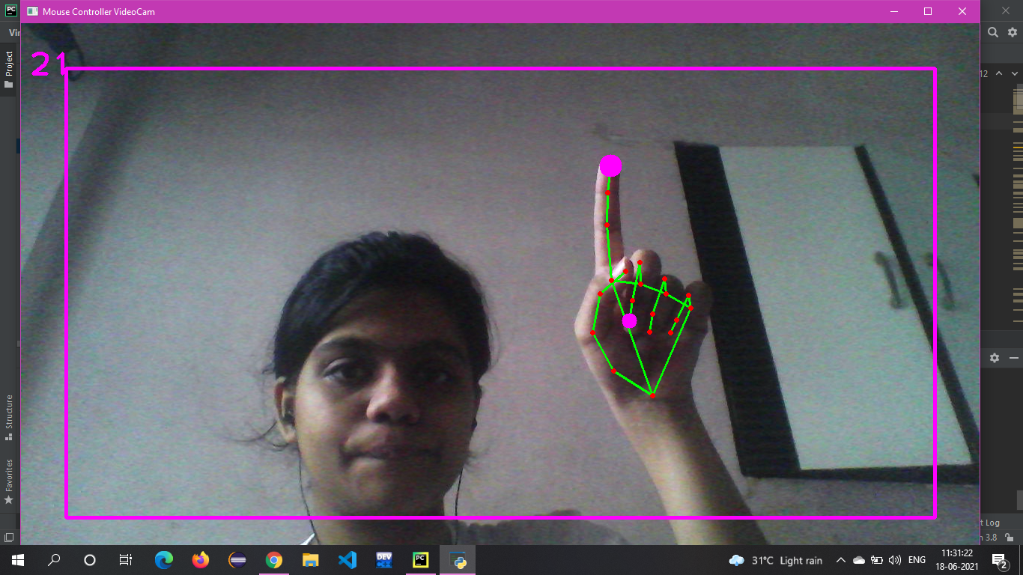
Day 3: Creating mouse controller

Slide 10
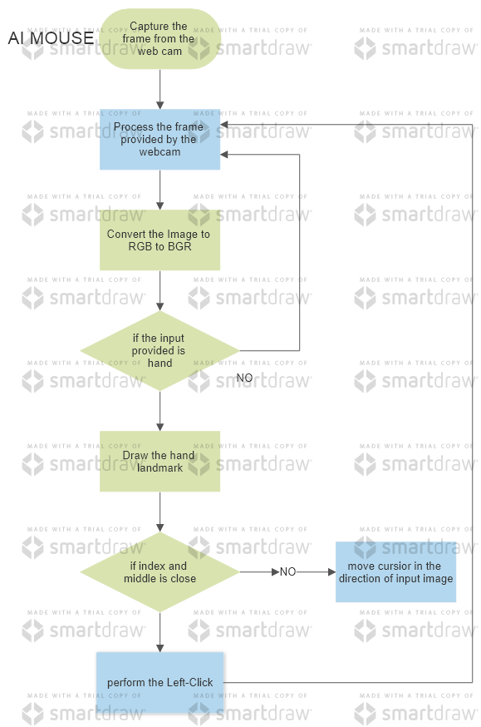
Flow chart

Slide 11
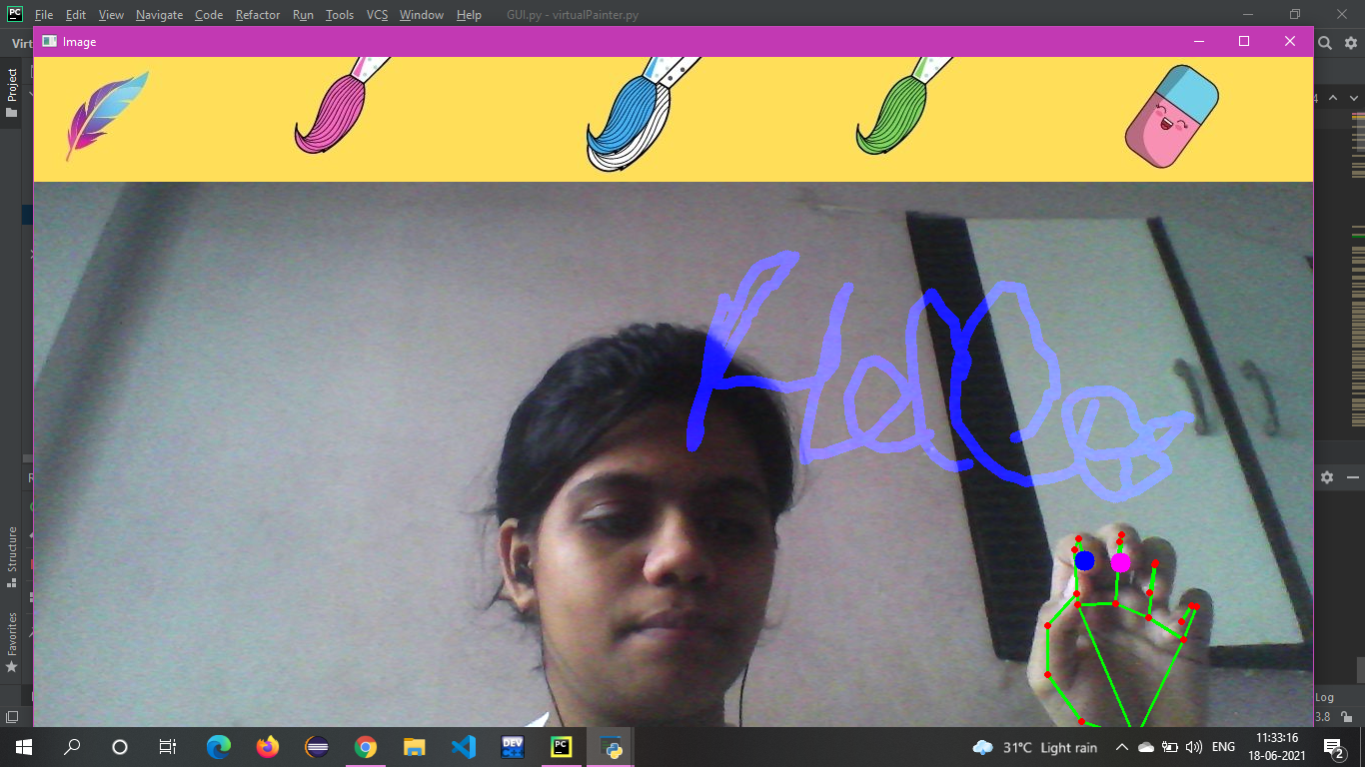
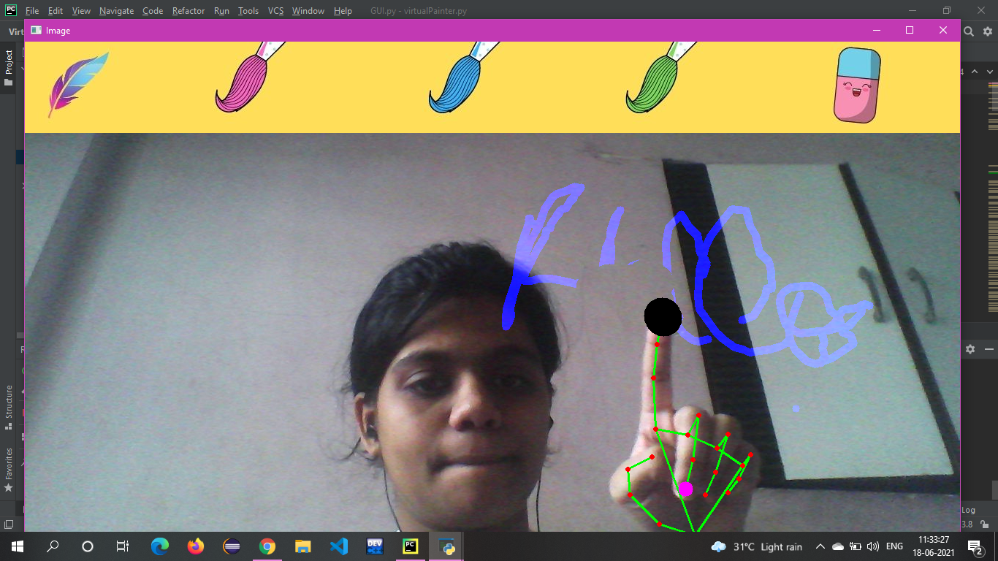
Day4 : Virtual paint

Slide 12
RESULTS AND EVALUATION
The motive of this project was to make the machine more interactive and responsive towards human behavior. The sole aim of this project was to make a technology that is affordable and portable with any standard operating system.
The proposed system is used to control the pointer of the mouse by detecting the human hand and moving the pointer in the direction in the human hand respectively. the system Control simple function of the mouse such as left-clicking, dragging and cursor movement.
The method detects the finger and palm at 21 point and tracks it continuously for the movement of the cursor when the distance between the index fingers and middle finger of the human hand is less closer to each other the process performs the task of the left-click.

